Slide 1
Code to register to this domain:
RIT

Slide 2
Code to add to domain: RIT
RIT

Slide 3
Added to domain: RIT
What would you like this device to be called?
Golisano Hallway 1

Slide 4
Device List:
Golisano Hallway 1

Slide 5
Tile List

Slide 6
Tile List

Slide 7
Tile List
Push to:
Golisano Hallway 1
Golisano Hallway 2

Slide 8
Golisano Hallway 1
Web Page
Title
Logo/image
Web Page
Description

Slide 9
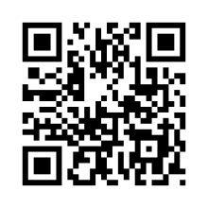
Golisano Hallway 1

Slide 10
Golisano Hallway 1

Slide 11
Golisano Hallway 1
Webpage Sample?

